Slide 1

DISEASE PREDICTION BASED ON SYMPTOMS Mini Project KCS 753/ 7th Sem
STUDENT NAME:
KUSHAGRA AGGARWAL (1900321290038)
SHREYAK YOGI (190032129006)
SARTHAK GUPTA (1900321290047)
SHREYA TYAGI (1900321290060)
SUPERVISOR NAME:
Mr. Ravindra Chauhan

Slide 2
ABSTRACT
Nowadays, people face various diseases due to the environmental condition and their living habits. So the prediction of disease at earlier stage becomes important task. But the accurate prediction on the basis of symptoms becomes too difficult for doctor.
Medical science has large amount of data growth per year. Due to increase amount of data growth in medical and healthcare field the accurate analysis on medical data which has been benefits from early patient care.
For disease prediction we required disease symptoms of the patient, which we use as our input to predict the disease based on that symptoms.

Slide 3
OBJECTIVE
There is a requirement to ground work and evolve a system that will enable end users to predict chronic diseases without having to visit a physician or doctor for diagnosis.
To identify various diseases by observing the symptoms of patients and applying various machine Learning algorithms.
Use of Machine learning algorithms improves the accuracy of predictions.
After successful prediction, user can be able to see the nearby hospitals for later treatment.

Slide 4
LITERATURE REVIEW
Analyzing the trends in treatment of patients for diagnosis of a particular disease will help in making informed and efficient decisions to improve the overall quality of healthcare.
The proposed disease prediction model helps the people to diagnose their diseases by providing the symptoms.
For some research paper, the main aim was to predict liver disease using different classification algorithms which help in exploring more algorithms.
This System predicts the arising possibilities of Heart Disease. The outcomes of this system provide the chances of occurring heart disease in terms of percentage.
.The goal is to introduce Healthcare analysts and practitioners to the advancements in the computing field to effectively handle data

Slide 5
LITERATURE REVIEW
The data is huge and provides an insight into future predictions, which might definitely prevent maximum medical cases from happening.
The knowledge germination concerning algorithms and algorithms utilization in the medical domain it can be noted that methods and methodologies have developed that have allowed complicated data reports by mild and honest use of algorithm like decision tree classifier.
This System predicts the arising possibilities of Heart Disease. The outcomes of this system provide the chances of occurring heart disease in terms of percentage.
Real-time data may be useful to analyze and predict severe emergency cases.

Slide 6
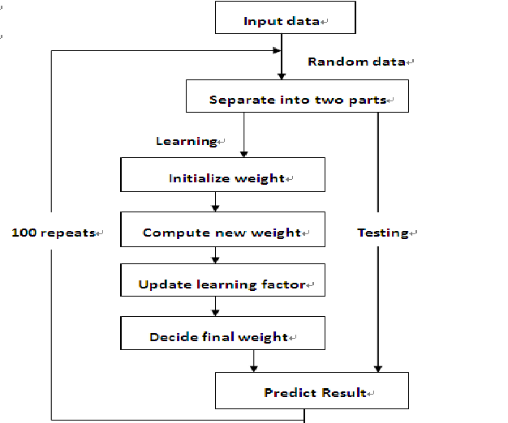
PROPOSED METHODOLOGY Data division into training and testing data

Slide 7
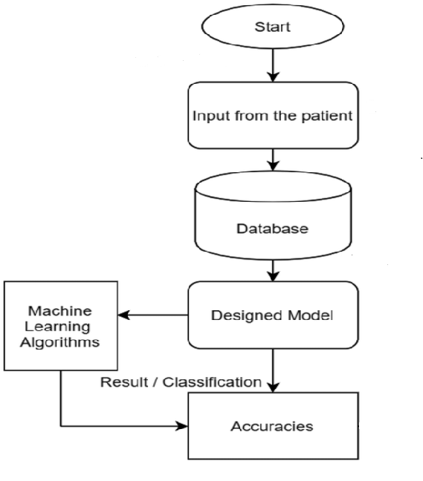
PROPOSED METHODOLOGY Result prediction
Test and Training data

Slide 8
TOOLS AND TECHNOLOGIES USED
Python
Tkinter
Numpy
Pandas
GooglePlaces
Naive Bayes Algorithm
Decision Tree Algorithm
Random Forest Classifier

Slide 9
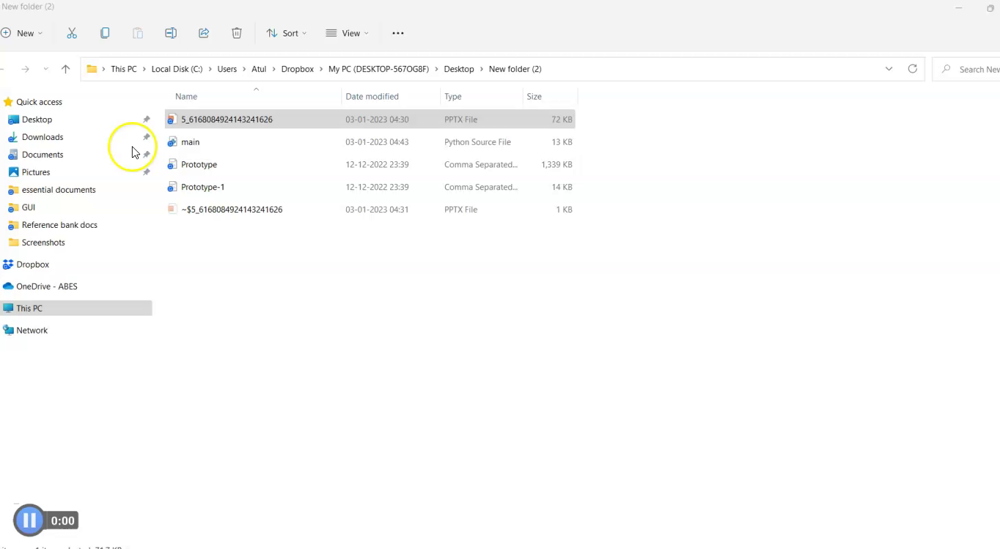
IMPLEMENTATION

Slide 10
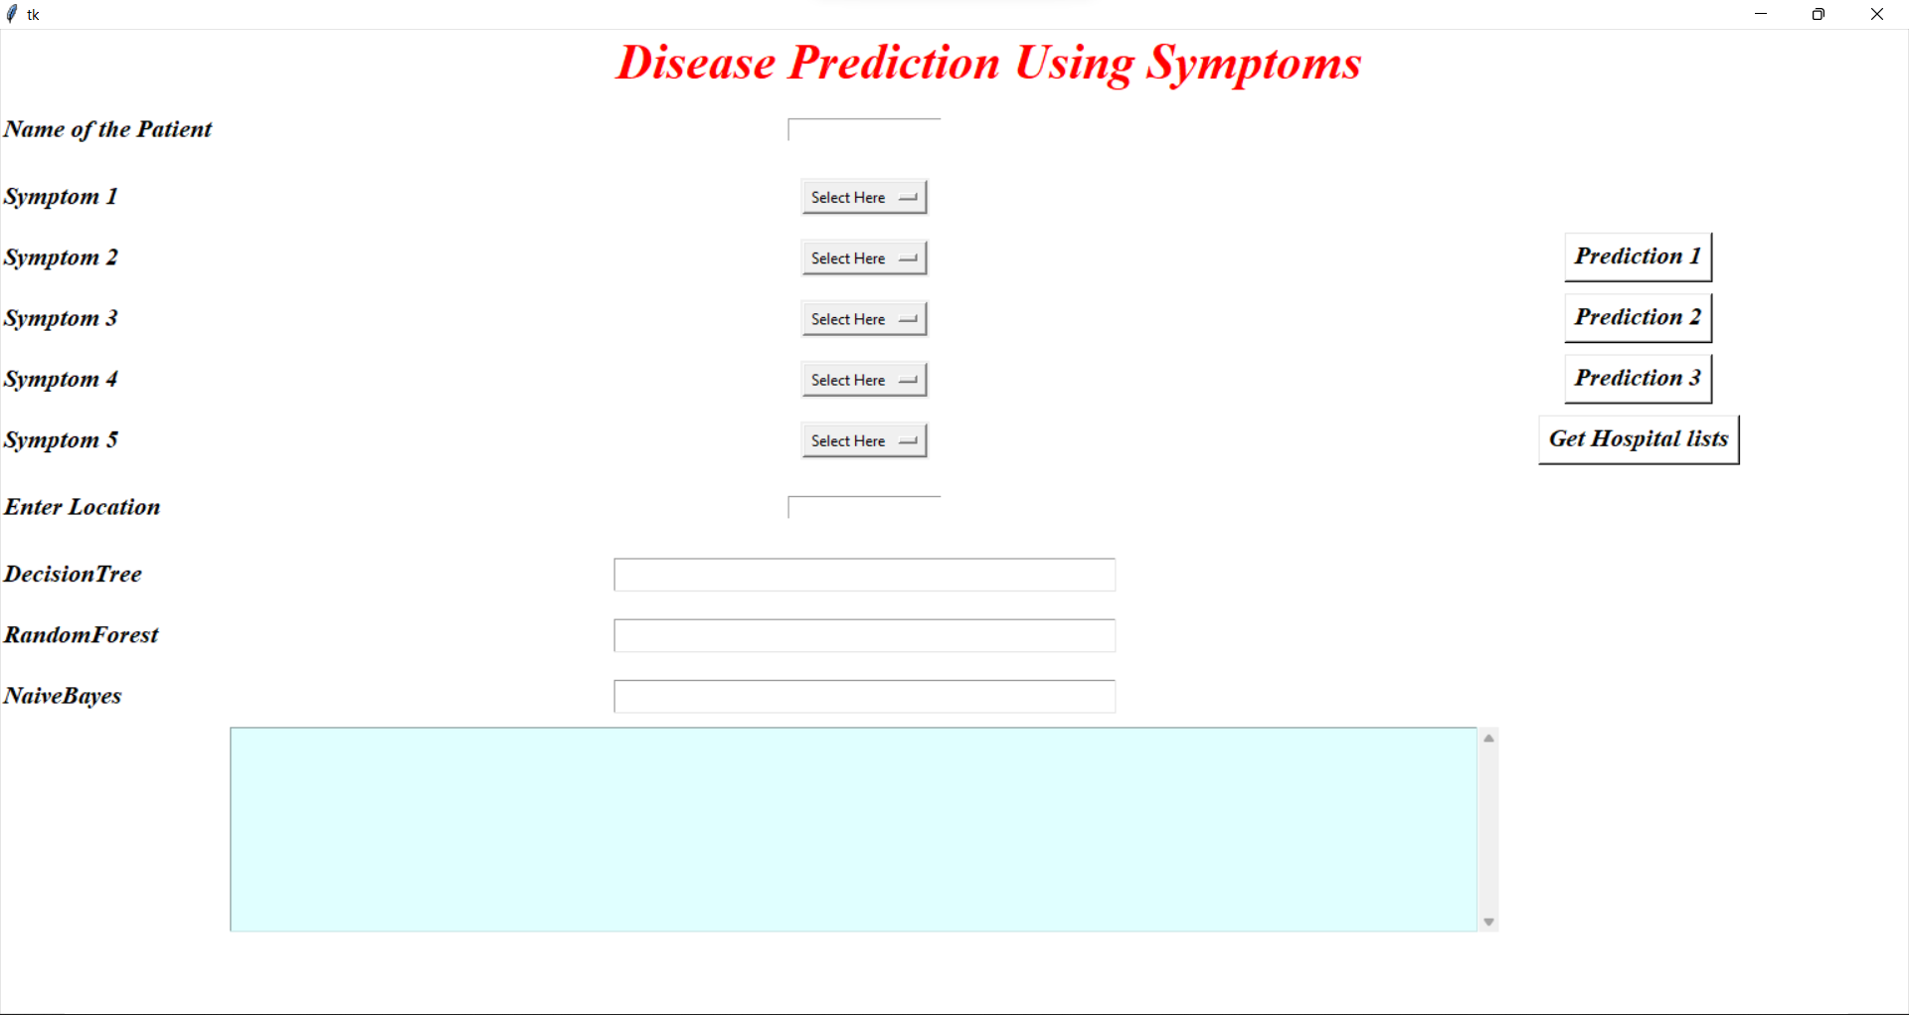
GRAPHICAL USER INTERFACE
The initial UI

Slide 11
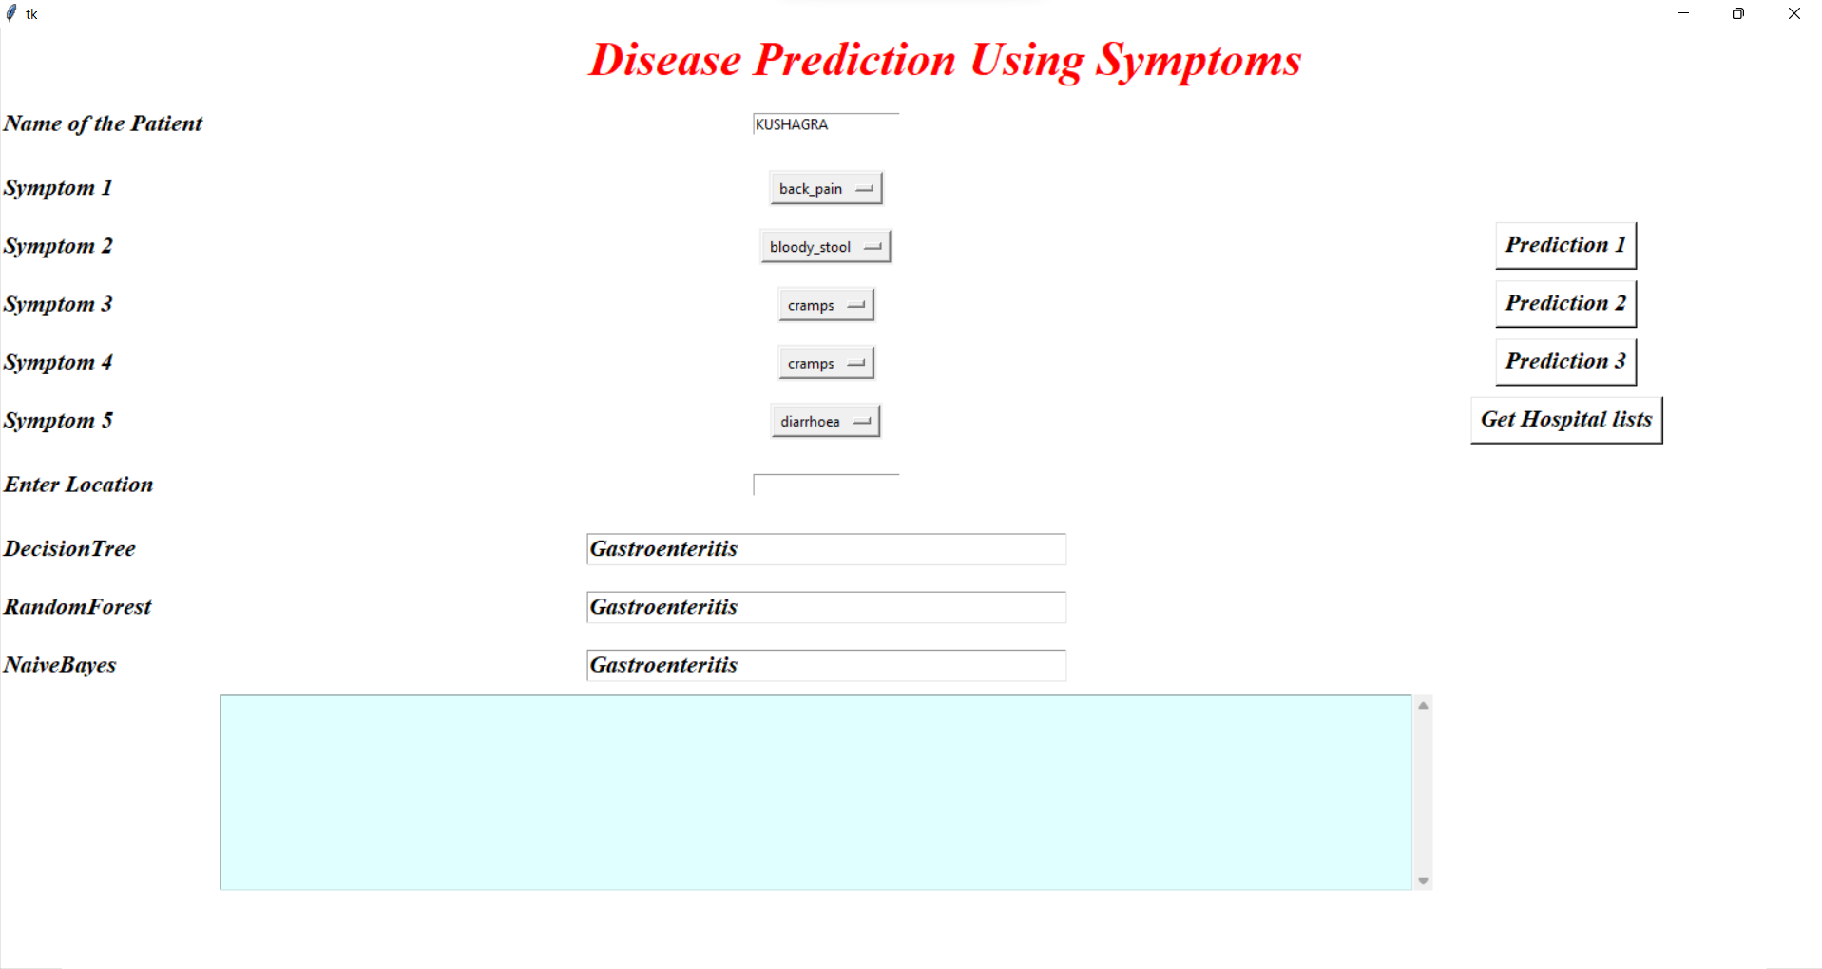
GRAPHICAL USER INTERFACE
UI after Disease Prediction

Slide 12
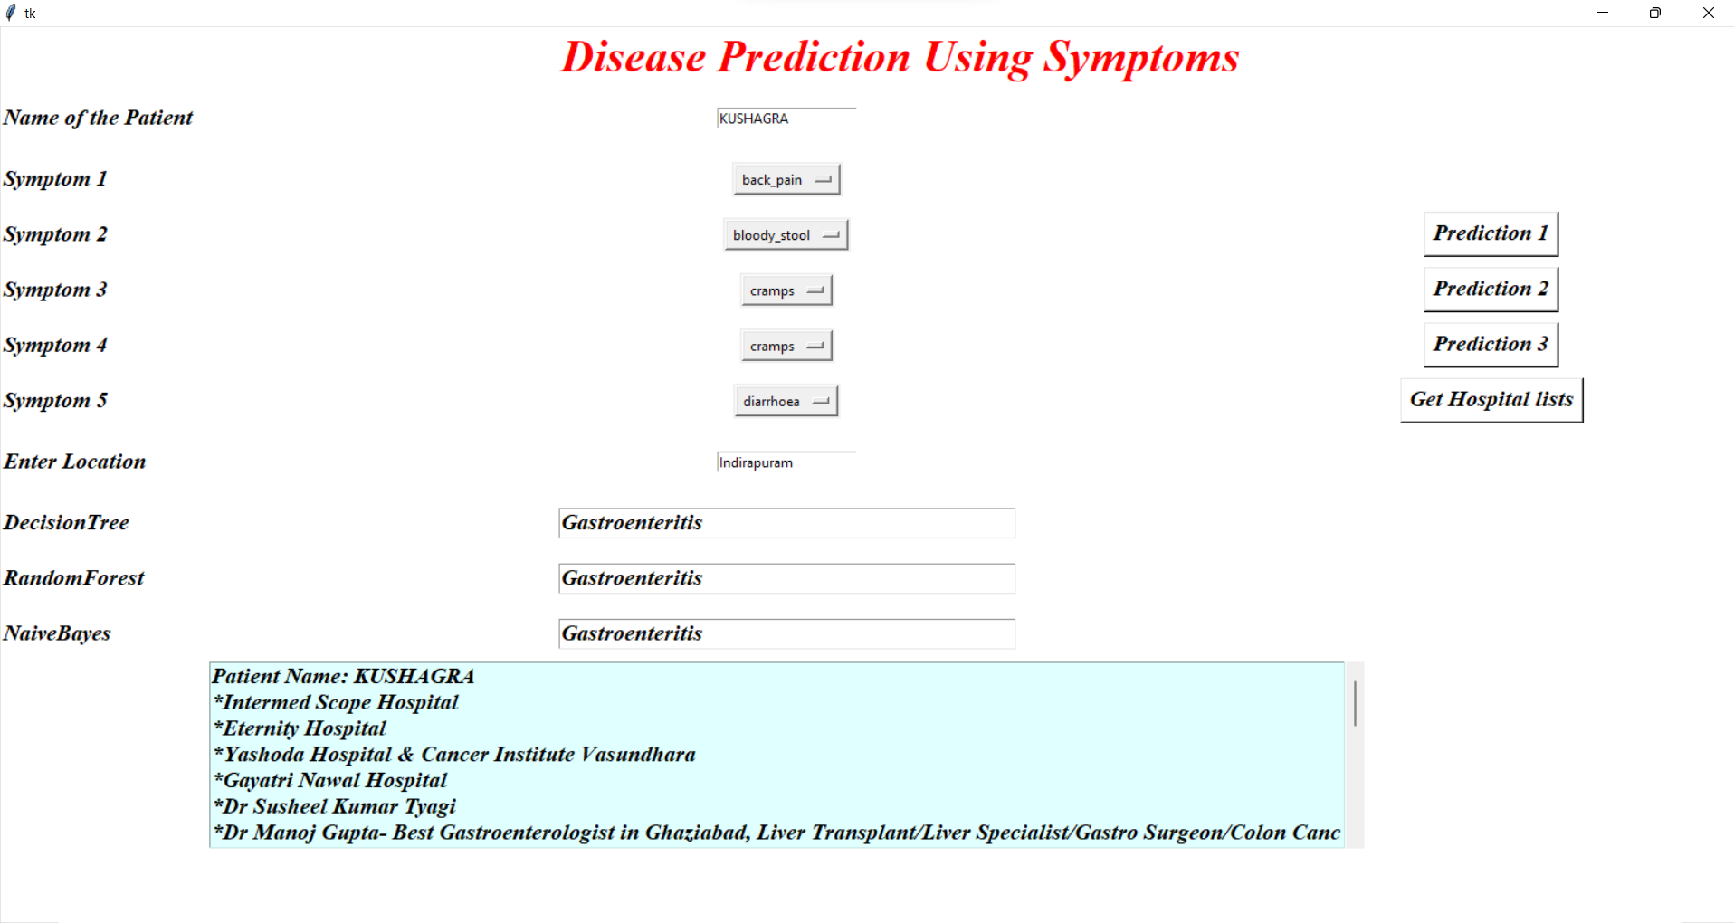
GRAPHICAL USER INTERFACE
Nearest hospital list along with patient name

Slide 13
IMPLEMENTATION
Word file Of The Code

Slide 14
RESULTS
This system can successfully predict Chronic disease based on the symptoms
The Overall accuracy in predicting disease is 82%.
The accuracy of different diseases vary, For example- For Common cold the accuracy is 88%.
Three different algorithms are used to increase the accuracy of the program.

Slide 15
CONCLUSION AND FUTURE SCOPE
We set out to create a system which can predict disease on the basis of symptoms given to it. Such a system can decrease the rush at OPDs of hospitals and reduce the workload on medical staff. We were successful in creating such a system and use 4 different algorithm to do so. Such a system can be largely reliable to do the job. Our system also has an easy to use interface. It also has various visual representation of data collected and results achieved.
The Further work will mainly focus on the Medical Assistance by providng the nearest hospital to the patients to build the best infrastructure and quickeasiest way in the Medical sectors.
Future work will be diagnosis the multiple symptoms and also provide the treatments. More intelligence can be incorporated into the organization with which the accuracy can be increased.

Slide 16
REFERENCES
https://www.geeksforgeeks.org/decision-tree/
https://www.geeksforgeeks.org/naive-bayes-classifiers/
https://www.javatpoint.com/machine-learning-random-forest-algorithm
Journal of healthcare engineering.
International Journal for research in applied science and engineering technology
Proceedings of the Fourth International Conference on Communication and Electronics Systems (ICCES 2019)
International Journal of advanced Computer and Mathematical Sciences, ISSN

Slide 17
THANK YOU

